Slide 1
Public Transport
Janesh Kapoor (Student) IIIT Delhi Naukri.com
Click here for Video Presentation
Public Transport and Sustainability: Enhancing Availability, Accessibility, and Hygiene for a Growing Population. As the cities become more populated, there’s an innate demand for the availability of public transportation and even more so for micro-mobility. With this dashboard, we aim to improve the overall road and transport infrastructure of our country.

Slide 2
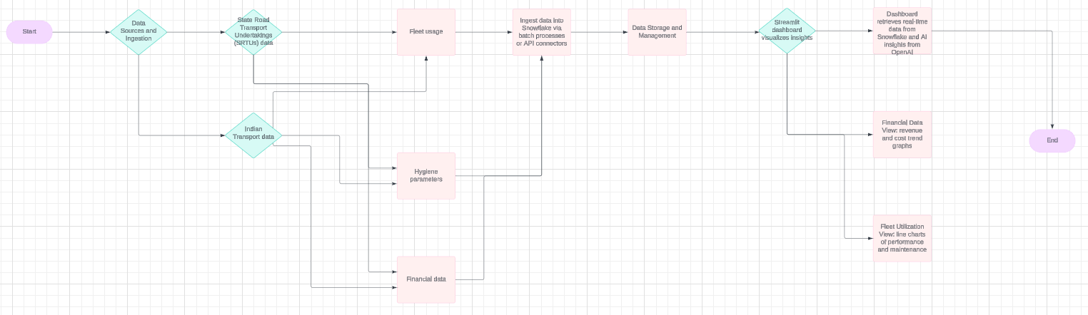
Hypothesis
Architecture Flow
Public transport systems in urban areas require proactive data-driven solutions to address growing demand and ensure sustainability.
Predictive analytics and real-time insights can optimize operations and help meet hygiene standards.
Technologies Used
Programming Languages and Libraries: Python, Streamlit, Matplotlib, Pandas, scikit-learn
Data Storage and Processing: Snowflake Database
Data Sources:
Resource | Open Government Data (OGD) Platform India.
Open Government Data (OGD) Platform India
Resource | Open Government Data (OGD) Platform India
Road Transport Year Book 2017-18 & 2018-19
Road Transport Year Book 2019-20

Slide 3
Authenticity – If the solution is yours and not copied. If it’s an improvement, mention it. This entire dashboard, from data collection and integration with Snowflake to building the Streamlit application and implementing predictive models, was developed entirely from scratch by me. Every aspect, including the connection setup, data visualization, insights generation, and recommendation models, is the result of my own efforts and understanding. The solution is purely authentic and has not been copied from any other project. However, if it coincidentally aligns with any existing project, I sincerely assure you that I was unaware of it during the development process for this hackathon. This project reflects my dedication and original thought process in addressing the problem statement.

Slide 4
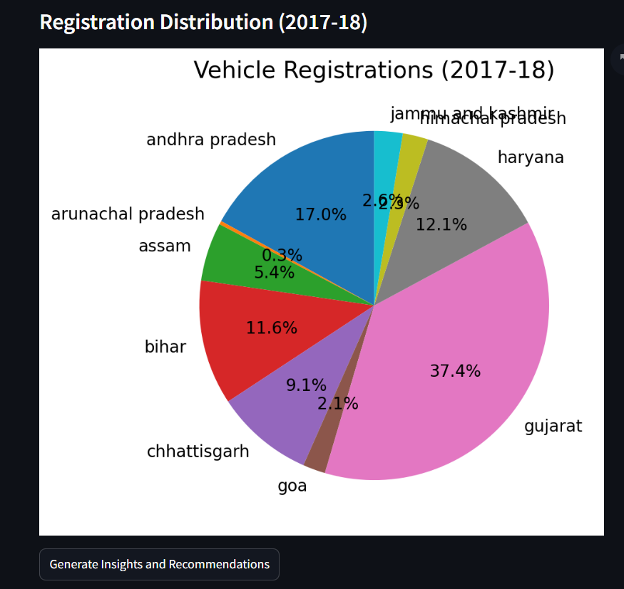
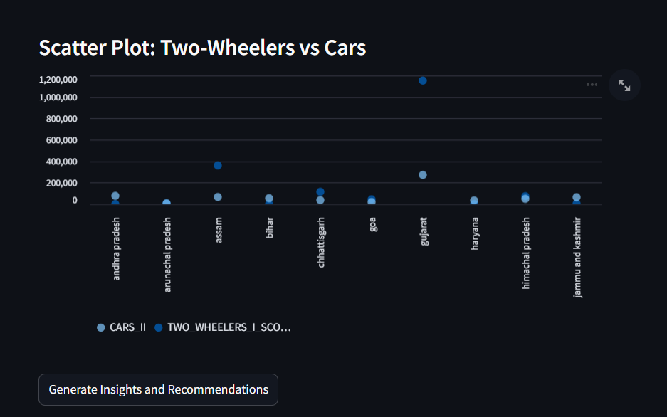
Explain Functional Requirements.
Core Functionalities:
Analyze trends in public transport data (revenue, vehicles, fleet).
Generate insights and predictions using AI.
Provide actionable recommendations for improving public transport availability and hygiene.
Mapping to Snowflake Features:
Snowflake's data querying and processing capabilities for structured datasets.
Snowflake’s data storage for storying more than 87 different tables.
Snowflake’s VS Code extension for quick access to tabular data using SQL Queries.
Streamlit for visualization and user interaction.

Slide 5
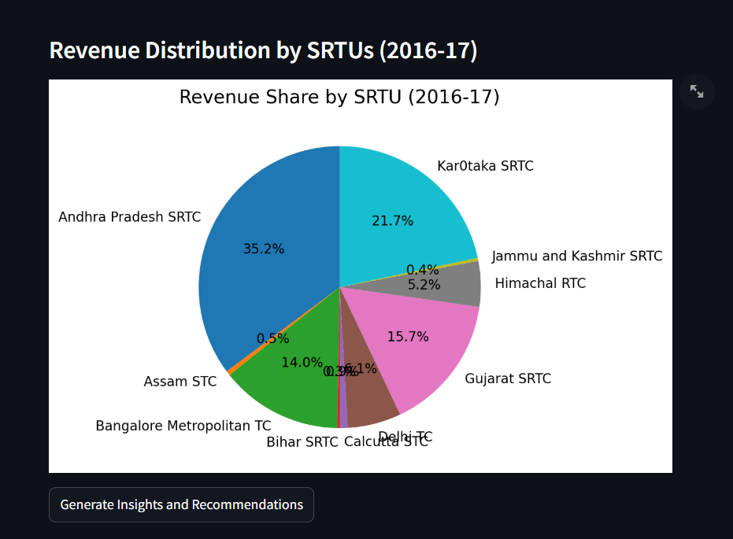
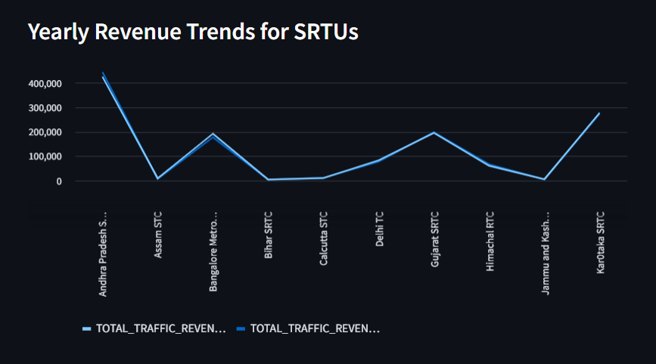
Insight and Recommendations #1
Insight
Title of Insight
Increased demand for micro-mobility solutions.
Revenue growth indicates potential for further investments.
Hygiene in public transport needs more focus

Slide 6
Error Handling & Validation
Key Error Encountered:
Issue: Initial attempts to connect Streamlit with the Snowflake backend failed.
Error Message: "Invalid account identifier" and other connection-related errors.
Root Cause:
Incorrect or incomplete configuration of the Snowflake connection parameters.
Misalignment in specifying the account's correct location and URL for the snowflake.connector library.
Resolution Steps:
Account Identifier Validation:
Verified the Snowflake account URL with my own URL.
Ensured the correct region specification (central-india.azure in this case).
Proper Configuration:
Updated the connection script with the correct parameters:
Double-checked against Snowflake's documentation for account naming conventions.
Ran multiple test queries to confirm connectivity. Validated the response consistency for queries executed via the Snowflake web interface and Streamlit backend

Slide 7
How does Snowflake & Streamlit add value to the overall solution?
1. Why was Snowflake considered for the solution Snowflake was chosen for its scalability, flexibility, and robust data processing capabilities. The platform's ability to handle vast datasets with high performance made it ideal for our application, which involves querying extensive public transport data in real-time. Snowflake's cloud-native architecture supports seamless integration with Streamlit and Python, enabling efficient data pipelines. Its support for structured and semi-structured data aligns well with the diverse datasets used in our analysis, such as revenue statistics, vehicle registrations, and fleet utilization data. 2. Are there alternatives? Alternatives to Snowflake exist, such as Google BigQuery, Amazon Redshift, and Microsoft Azure Synapse Analytics, each offering competitive features.

Slide 8
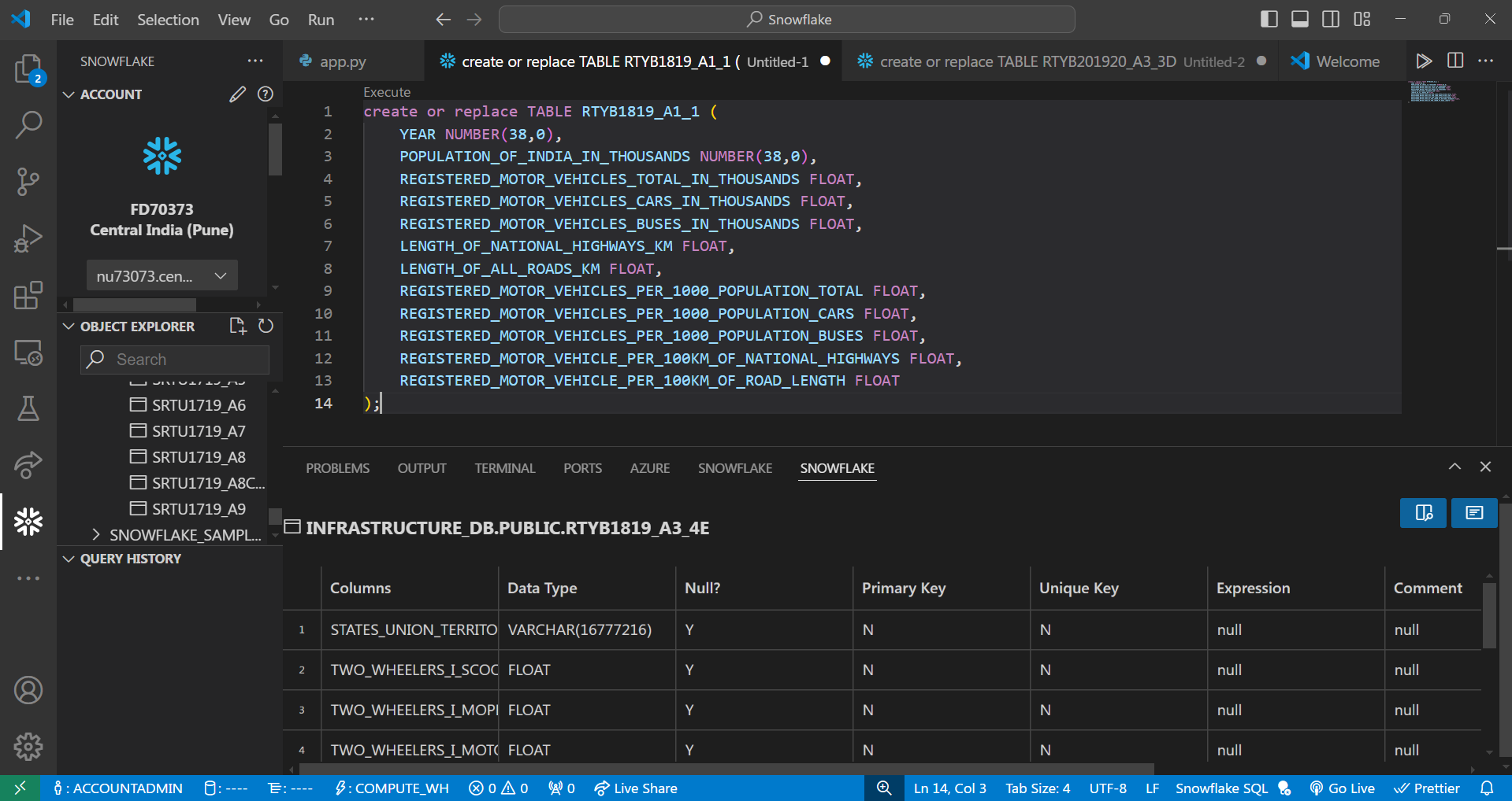
Snowflake Dev Tools Usage : (Eg. VSCode Extensions, Snowflake CLI, REST API etc.) During the development process, the Snowflake VS Code extension proved invaluable in managing over 87 different tables efficiently. By integrating Snowflake directly into my development environment, I was able to parse, modify, and execute SQL queries seamlessly without switching to the online Snowflake platform. This integration allowed me to focus on creating and structuring tables directly within VS Code, which significantly streamlined the workflow. The time-saving capabilities of the extension were especially evident when dealing with repetitive tasks like table creation, schema modifications, and bulk operations. This setup not only reduced overhead but also enhanced productivity, allowing me to dedicate more time to building the data-driven insights and predictive models for the project.

Slide 9
(Optional: What are possible non-functional requirements (NFRs)
Scalability: The dashboard can seamlessly handle increased data loads as more cities or transport modes are added. Snowflake's backend ensures fast processing and querying, enabling the dashboard to grow with the expansion of public transportation networks.
Usability: Designed with an intuitive interface, the dashboard ensures that users from diverse backgrounds—policy makers, urban planners, and citizens—can extract actionable insights effortlessly. Visualizations like line charts, bar graphs, and pie charts make complex data accessible and easy to interpret.
Performance and Reliability: By leveraging Snowflake's robust cloud infrastructure, the dashboard delivers real-time data analysis with minimal latency. This ensures uninterrupted access to insights, especially during critical decision-making periods.
Support for Decision Making: With predictive models integrated into the dashboard, users can proactively plan for future transportation needs. Recommendations on hygiene and infrastructure improvements further ensure that public transportation systems meet growing demand efficiently.

Slide 10
THANK
YOU

